Slide 1
Microsoft AI Skills Fest

Slide 2
Build applications with GitHub Copilot agent mode
Ari LiVigni
Senior Cloud Solutions Architect & Learning Evangelist

Slide 3

Ari LiVigni Senior Cloud Solutions Architect Learning Evangelist @arilivigni
Hobbies/Interests
Coaching Lacrosse
Ultimate Frisbee
3D printing
Peloton
Flying drones

Slide 4

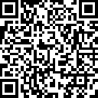
Welcome to the Microsoft AI Skills Fest
Housekeeping/Setup slide, external | 2 steps
Before we get started make sure you register and follow the steps to earn your badge.
1
2
Join our fun GUINNESS WORLD RECORDS™ title attempt
Ask questions and share your thoughts
Earn your badge:
Step 1: If you haven’t yet, take a moment to register: https://aka.ms/AISkillsFest
Step 2: Attend this session
Step 3: Complete a final step (shared at the end)
With your peers and our Microsoft AI Experts (“Live Moderators”) in the chat
Notes:
30 sec | [Slide: Session Housekeeping & Setup] (Slide 3)
Here are a few quick reminders to get the most out of this session:
Join the GUINNESS WORLD RECORDS™ title attempt!
If you haven’t registered yet, take a moment now so you don’t miss out on this exciting record-breaking attempt.
You’ll be asked to provide an email where we’ll send your badge after the session.
How to earn your badge? Attend this session and complete a simple step we’ll share at the end!
Engage with your peers and experts! Learning is better when we do it together. Drop your questions and thoughts in the chat as we go. We have Microsoft AI experts on standby, ready to help.
Great! Now that we’re set up, let’s talk about what we’ll be covering today.

Slide 5
Agenda
Introduction of GitHub Copilot agent mode
Learning objectives users will achieve in this skills course
Exploring the Power of GitHub Copilot agent mode
Skill Background: OctoFit Tracker application
Let's dive into working on the skill Build applications with GitHub Copilot agent mode - OctoFit Tracker application

Slide 6
Introduction of GitHub Copilot agent mode
Next evolution of AI-assisted development
An autonomous peer programmer
Analyzes your codebase to gather full context
Agent mode iterates on its own code
Notes:
Speaker Notes:
Experience the next evolution of AI-assisted coding with GitHub Copilot agent mode
An autonomous peer programmer capable of performing multi-step coding tasks at your command
It analyzes your codebase, reads relevant files, proposes file edits, and runs terminal commands and tests
Agent mode iterates on its own code, recognizing errors and fixing them automatically
Available as a preview feature for VS Code Insiders users

Slide 7
Learning objectives users will achieve in this skills course
Understand how to develop with VS Code IDE in a GitHub Codespace
Prompt GitHub Copilot agent mode to create an application
Leverage documentation files to instruct GitHub Copilot agent mode
GitHub Copilot agent mode iterates over a code base to:
Fix errors
Refactor code
Develop new features

Slide 8
Exploring the power of GitHub Copilot agent mode
Autonomous operation
Multi-step tasks
Tools for task completion
Code changes and terminal commands
Iteration and self-healing
User control and review
Context management
Undo and Redo
Interrupting requests
Limitations
Notes:
Speaker Notes:
Exploring the Power of GitHub Copilot Agent Mode (Preview)
Autonomous Operation: Copilot agent mode operates in a more autonomous and dynamic manner to achieve the desired outcome. It determines the relevant context and files to edit autonomously, without explicit user specification
Multi-Step Tasks: It can perform multi-step coding tasks1 ..., such as creating apps from scratch, performing refactorings across multiple files, and writing and running tests
Tools for Task Completion: Agent mode uses a set of tools to perform specific tasks like editing files and running terminal commands. These tools can run in parallel . Examples include listing files, reading file contents, running terminal commands, and getting terminal output
Code Changes and Terminal Commands: Copilot suggests both code changes and terminal commands to complete the task. It might compile code, install packages, and run tests
Iteration and Self-Healing: Agent mode iterates independently to achieve the desired outcome, fixing issues as they come up. It monitors the correctness of code edits and terminal command output and iterates to remediate issues. It can detect issues and problems in code edits and terminal commands and perform additional actions to resolve them. It also analyzes run-time errors with self-healing capabilities
User Control and Review: You stay in control of the changes that are made and can review the generated edits. Copilot requests confirmation before running terminal commands. You can also modify proposed terminal commands before running them
Context Management: While autonomous, you can still explicitly reference context with #file, using drag and drop or the "Add Files" button. You can also use #codebase in your prompt to let Copilot find the right files automatically (requires enabling the github.copilot.chat.codesearch.enabled preview setting)
Undo and Redo: You can use the "Undo Last Edit" control to revert the last edits
Interrupting Requests: You can pause or cancel an ongoing agent mode request
Settings: Several settings are specific to agent mode, such as chat.agent.maxRequests (maximum number of requests) and github.copilot.chat.agent.runTasks (run workspace tasks)
Limitations: Agent mode is currently in preview and available in VS Code Insiders. It might take longer to get a response due to multiple steps. It can be more non-deterministic than edit mode. It may also quickly use up your free Copilot quota as it may send multiple requests per prompt. Agent mode is not available for working with notebooks in VS Code

Slide 9
Skill Background: OctoFit Tracker Application
Setting: Mergington High School
Characters
Paul Octo
Jessica Cat
The Challenge
Students rarely exercise outside of required PE classes
Need for a fun, engaging way to track fitness activities
The Solution: OctoFit Tracker app
Social fitness tracking application
Built with GitHub Copilot agent mode
Compliant with school policies (docs/mergington-tech-policies.md)
Key Features
User profiles and activity logging
Team competitions and leaderboards
Personalized workout suggestions
Progress tracking dashboard
Your Task
Follow Paul's journey using GitHub Codespaces
Learn to leverage GitHub Copilot agent mode
Build a similar application with help of GitHub Copilot agent mode

Slide 10
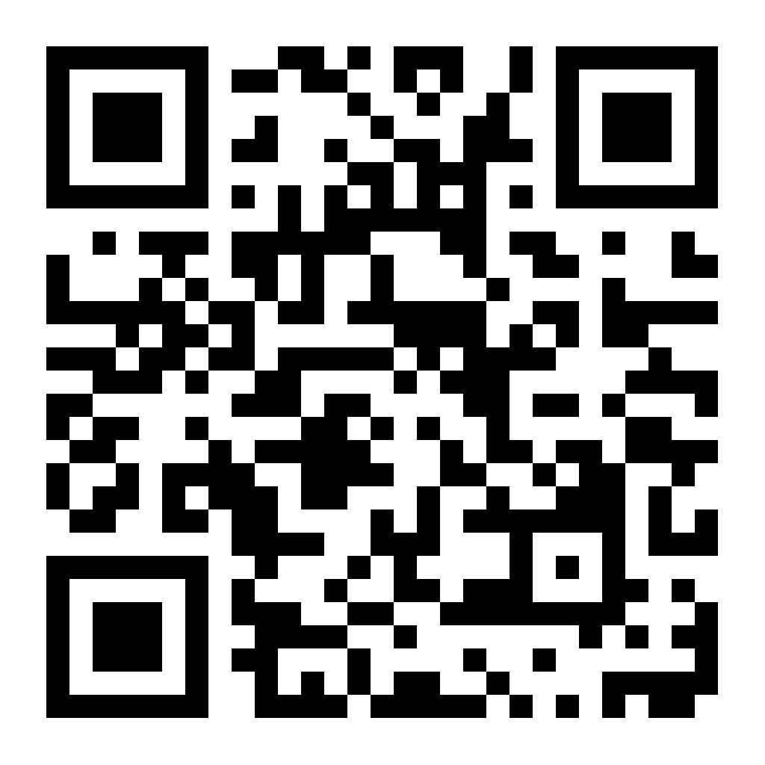
Let's dive into working on the skill: Build applications with GitHub Copilot agent mode OctoFit Tracker application
https://gh.io/build-app-agent-mode

Slide 11



Kickoff Celebration Closing/Reminder, external
1
Confirm your participation
Verify your involvement on the attestation page for the GUINNESS WORLD RECORDS™ title attempt
https://aka.ms/TrainingAffirmation
Congratulations
You’ve achieved a new AI learning milestone
2
Share your success
Show off your achievement—post your milestone with #AISkillsFest
Notes:
1.5 min | [Closing & Reminder]
To celebrate your achievement, make sure to confirm your participation and download your GUINNESS WORLD RECORDS™ title attempt badge. How? Make sure to take steps on the screen. Take a moment to acknowledge your progress—this is a unique achievement!
Also, remember to share your success—you should feel proud of yourself achieving this milestone. Share what you learned in this session on LinkedIn or with your own network. Tag your colleagues and friends who might benefit from AI skills training. Use the hashtag #AISkillsFest to connect with others on their AI journey.
Congratulations once again and thank you for being part of this AI learning experience!

Slide 12
Thank you for attending

